Slide 1
POVs and Experience Prototypes
CS147 Studio: Digital Democracy

Slide 2
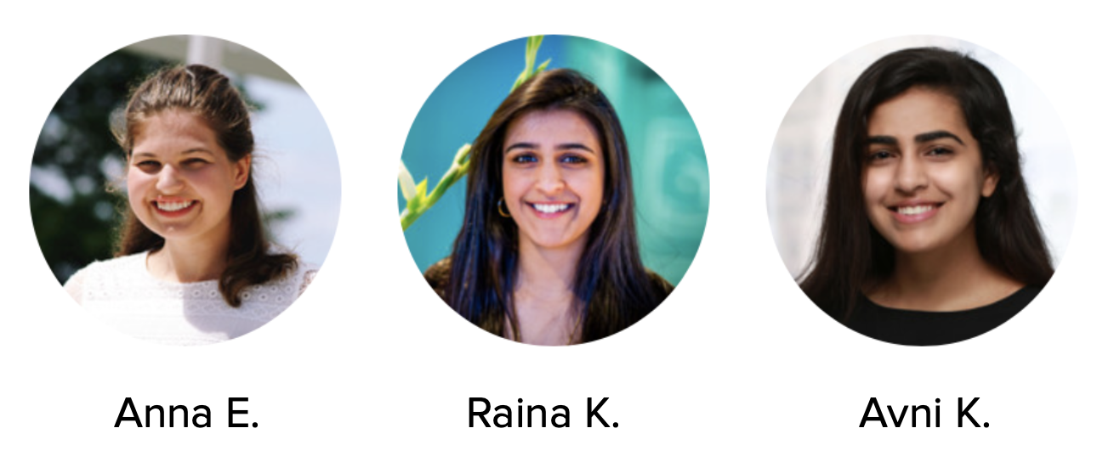
Political Education in Gen Z
Our Team
Notes:
Our studio theme is Digital Democracy. We have narrowed down our problem domain to political education in Gen Z, a term used for people born from 1996 onwards. Our initial needfinding revealed an interesting tension between young people wanting to know more about politics, but felt as though it was extremely difficult to simplify those news, and instead relied on their parents’ political views to inform their own.

Slide 3
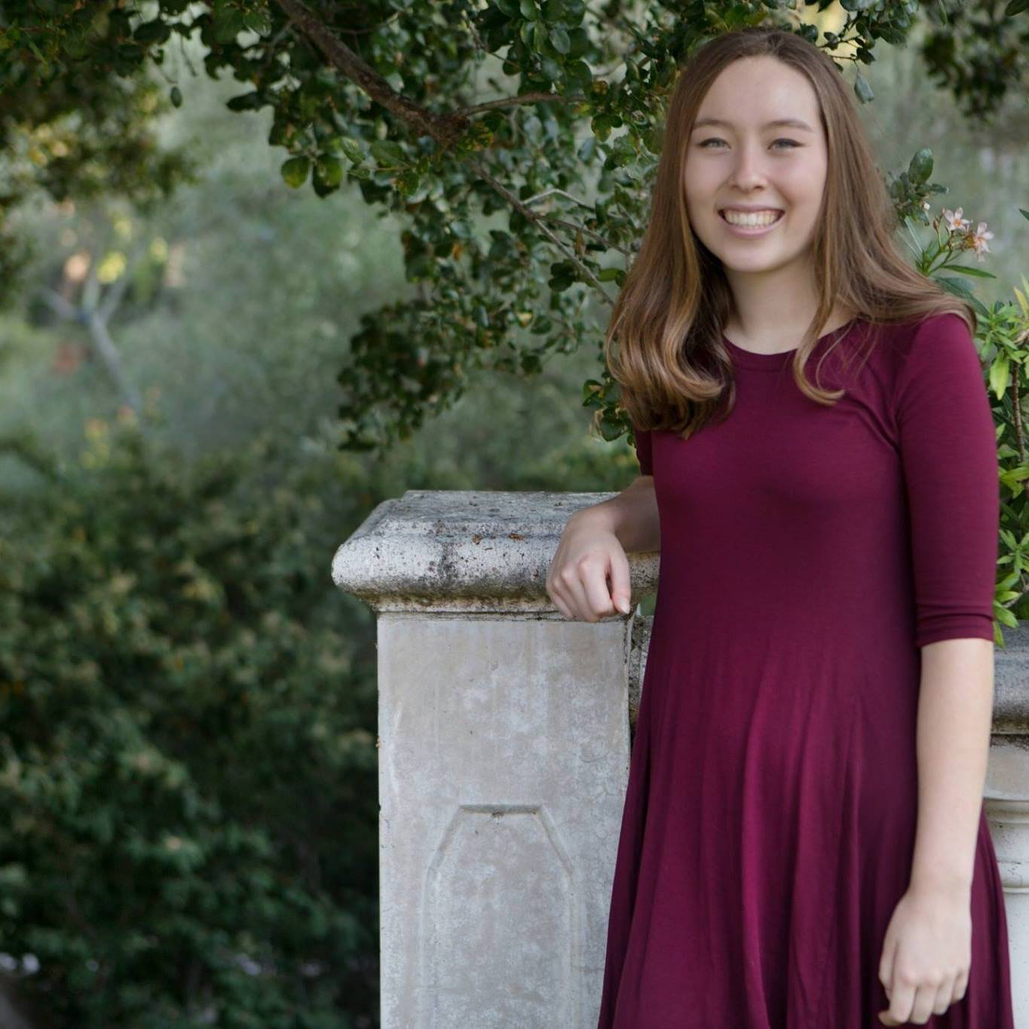
Initial POV
We met Christie, a sophomore at Stanford from Menlo Park, whose father used to be a local politician, but does not consider herself politically engaged. We were amazed to realize that she relies on her parents to tell her who to vote for. It would be game-changing to empower young and first-time voters to make their own decisions on who to vote for.

Slide 4
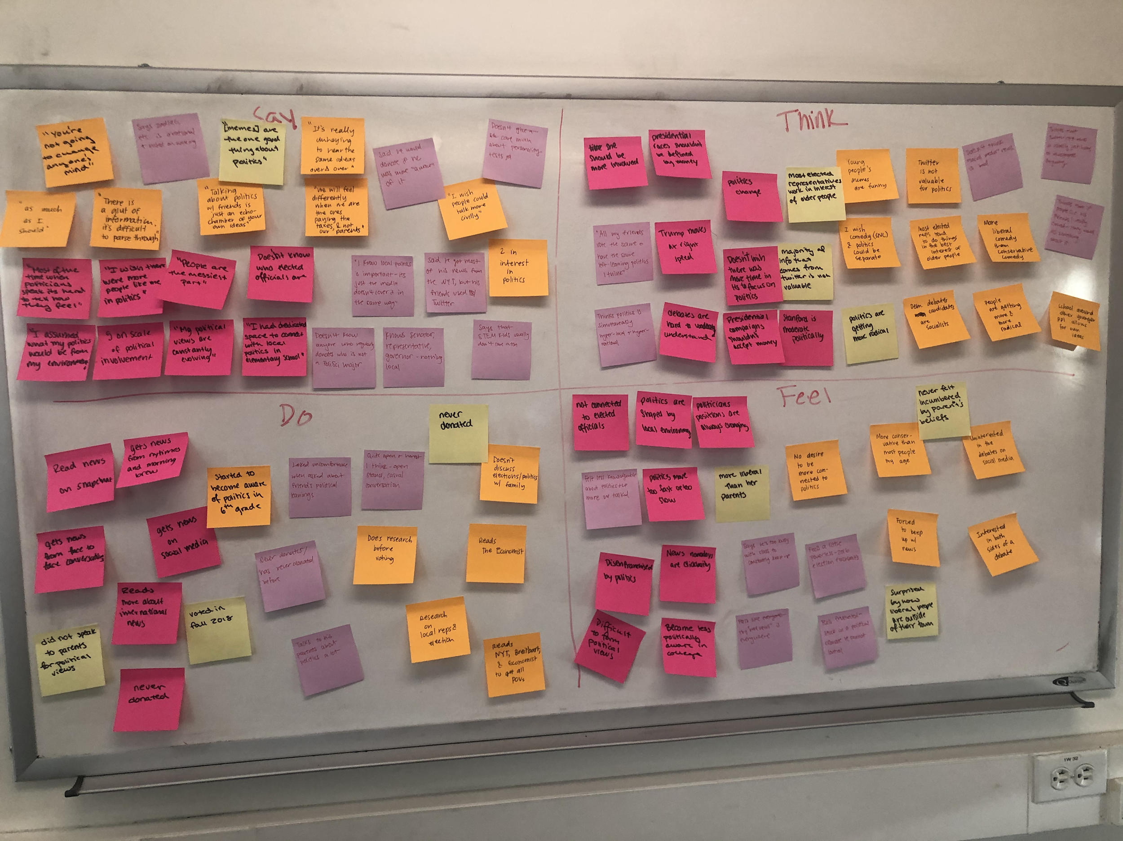
3 Additional Interviews
Giulia, Sejal, and Arjun

Slide 5
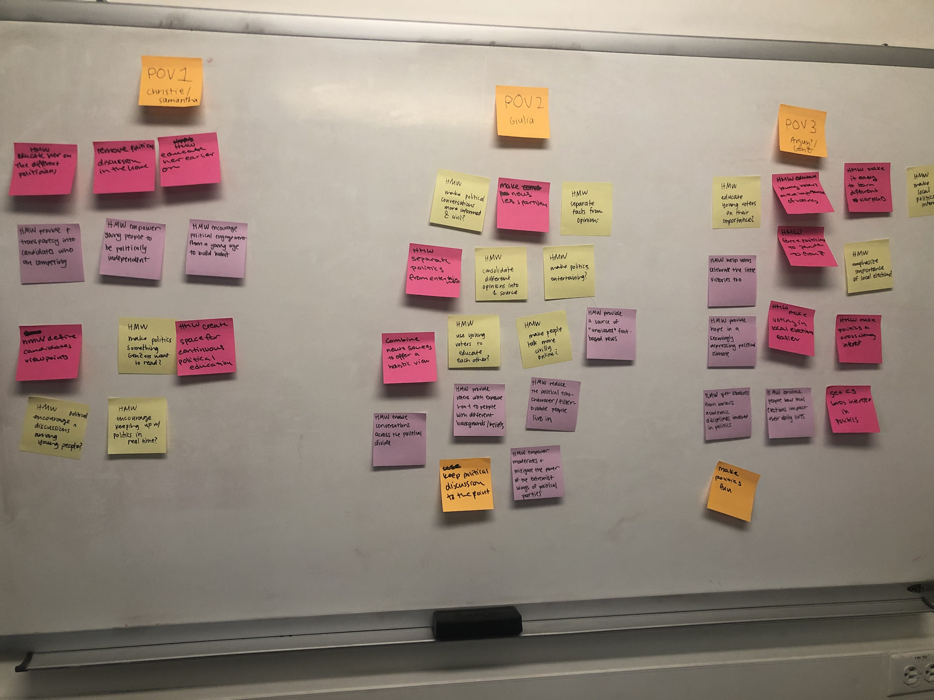
POV Development
Samantha, Giulia, and Arjun

Slide 6

POV 1: Samantha
We met Samantha, a junior at UC Santa Barbara, studying CS. She struggles with who to vote for and feels pressure from her family and friends. She is not involved with politics, does not know who her senators and representatives are. We were amazed to realize that she especially struggled with who to vote for within the Democratic Party. She thinks that they all seem to be advocating for the same thing. It would be game-changing to educate her on the differences between the political candidates and who would best advocate for her.

Slide 7
HMW make politics fun and something Gen Z cares about?

Slide 8
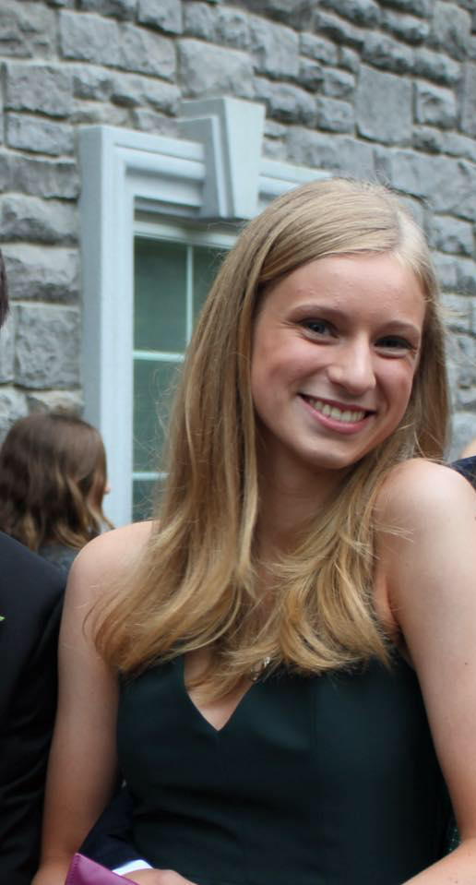
POV 2: Giulia
We met Giulia, an 18 year old freshman at Stanford. She is very much disenfranchised with politics, mainly because she feels like politics today is too radical and is an echochamber of the same views. She does not claim to be politically interested, but knows her local politics and national politics well. We were amazed to realize that she reads a variety of news sources in order to get different political perspectives. She reads liberal (NYT), conservative (Breitbart), and moderate news sources to do so. It would be game-changing to have people learn about various different perspectives in order to make political conversations more informed and civil.

Slide 9
HMW use young voters to educate each other?

Slide 10
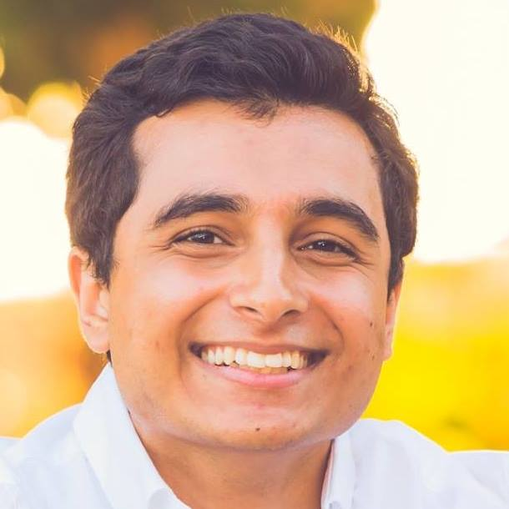
POV 3: Arjun
We met Arjun, a sophomore at the University of Washington studying CS. He considers himself a product of his surroundings and upbringing in the Seattle area. He does not feel like many people with his academic interests are also interested in politics. We were amazed to realize that he felt like he had no power in the political process. It would be game changing to make people realize the power of their votes, in both local and national politics.

Slide 11
How might we encourage continuous, fact-based, political engagement?
HMW encourage continuous, fact-based engagement?

Slide 12
Experience Prototypes

Slide 13
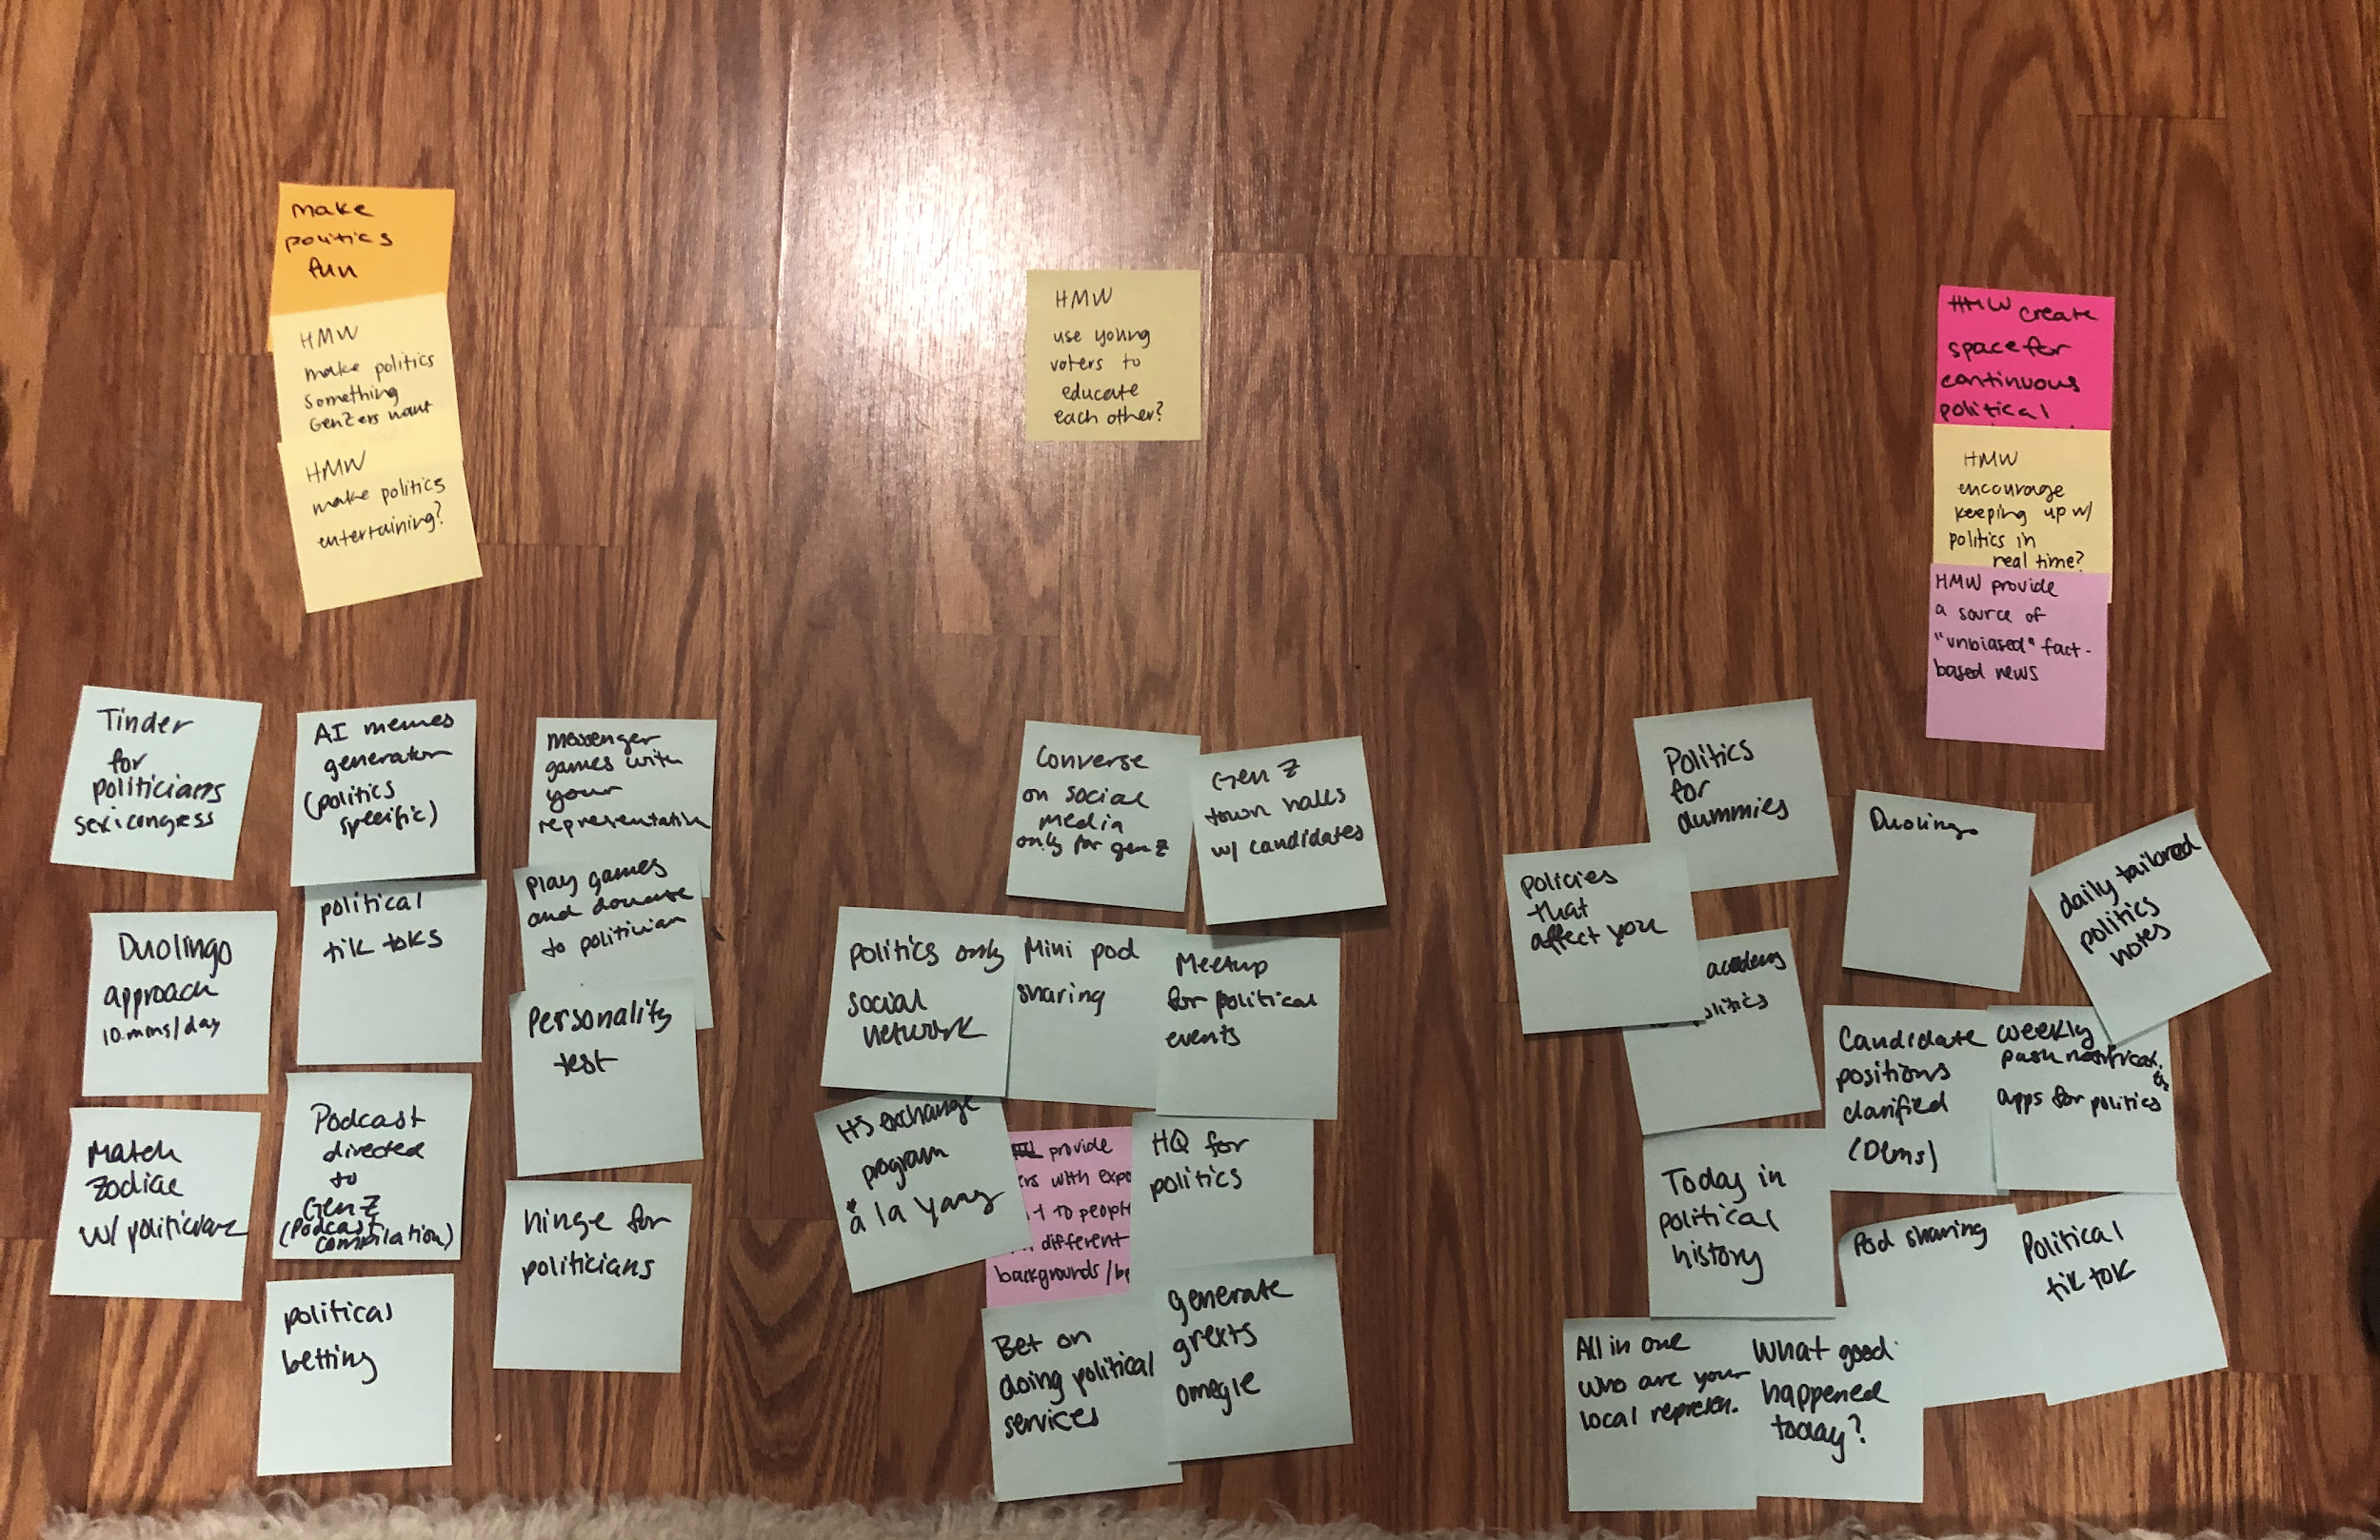
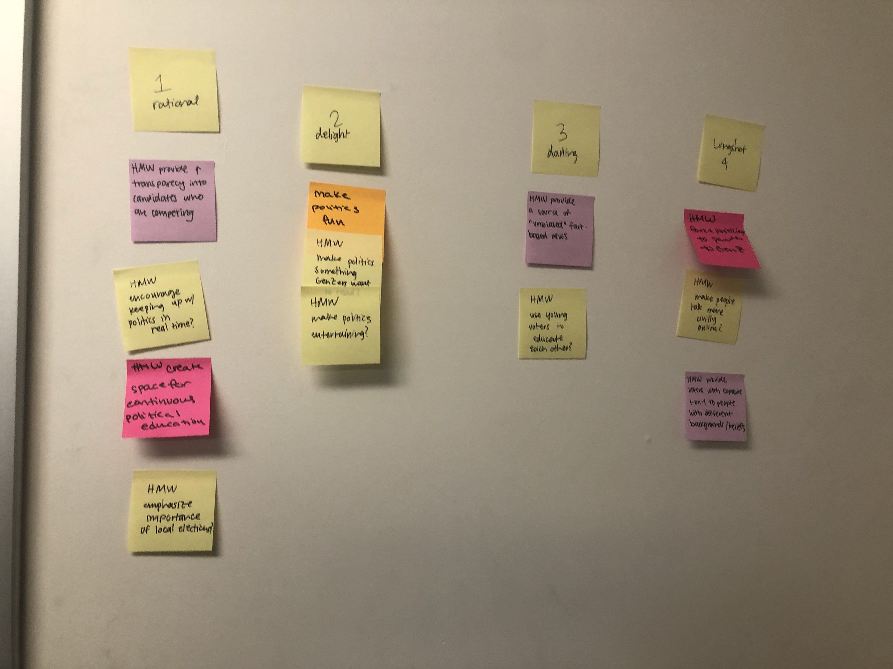
Brainstorming

Slide 14
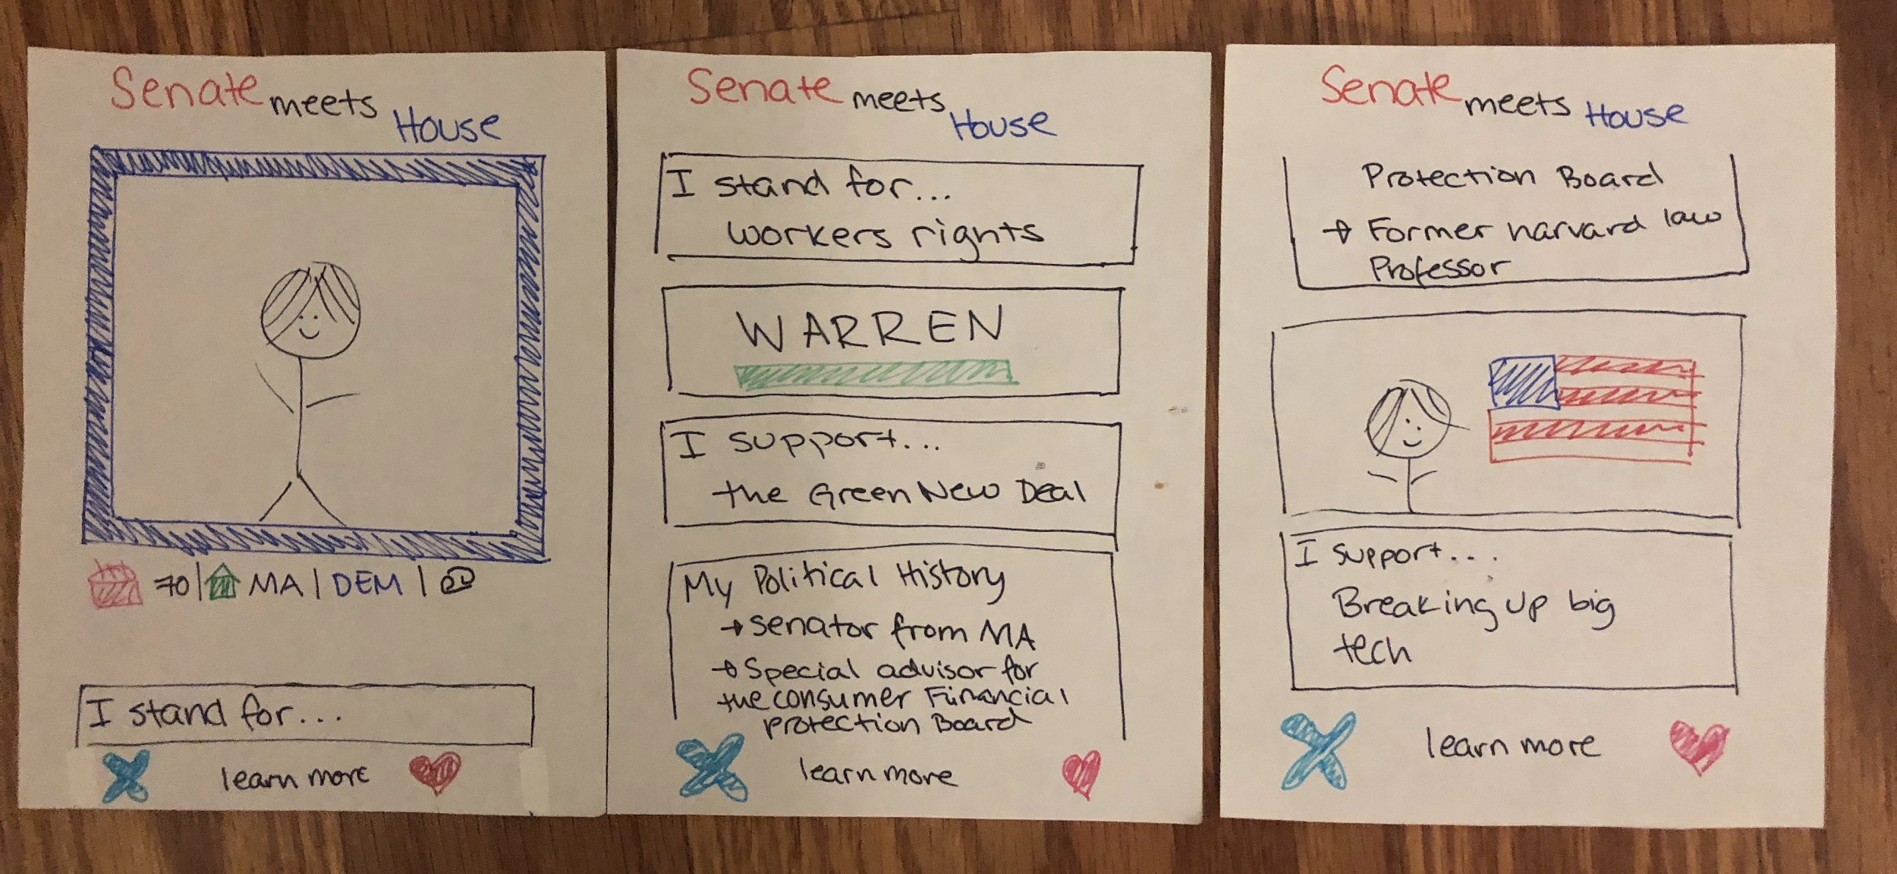
PROTOTYPE 1: Senate Meets House

Slide 15
Senate Meets House
Assumption
Fun, not inherently political activities can make political engagement more accessible
Positives
Delightful
Easy to use
Useful in deciding between candidates in the same party
Negatives
Too casual/not informative enough
No continuous updating

Slide 16
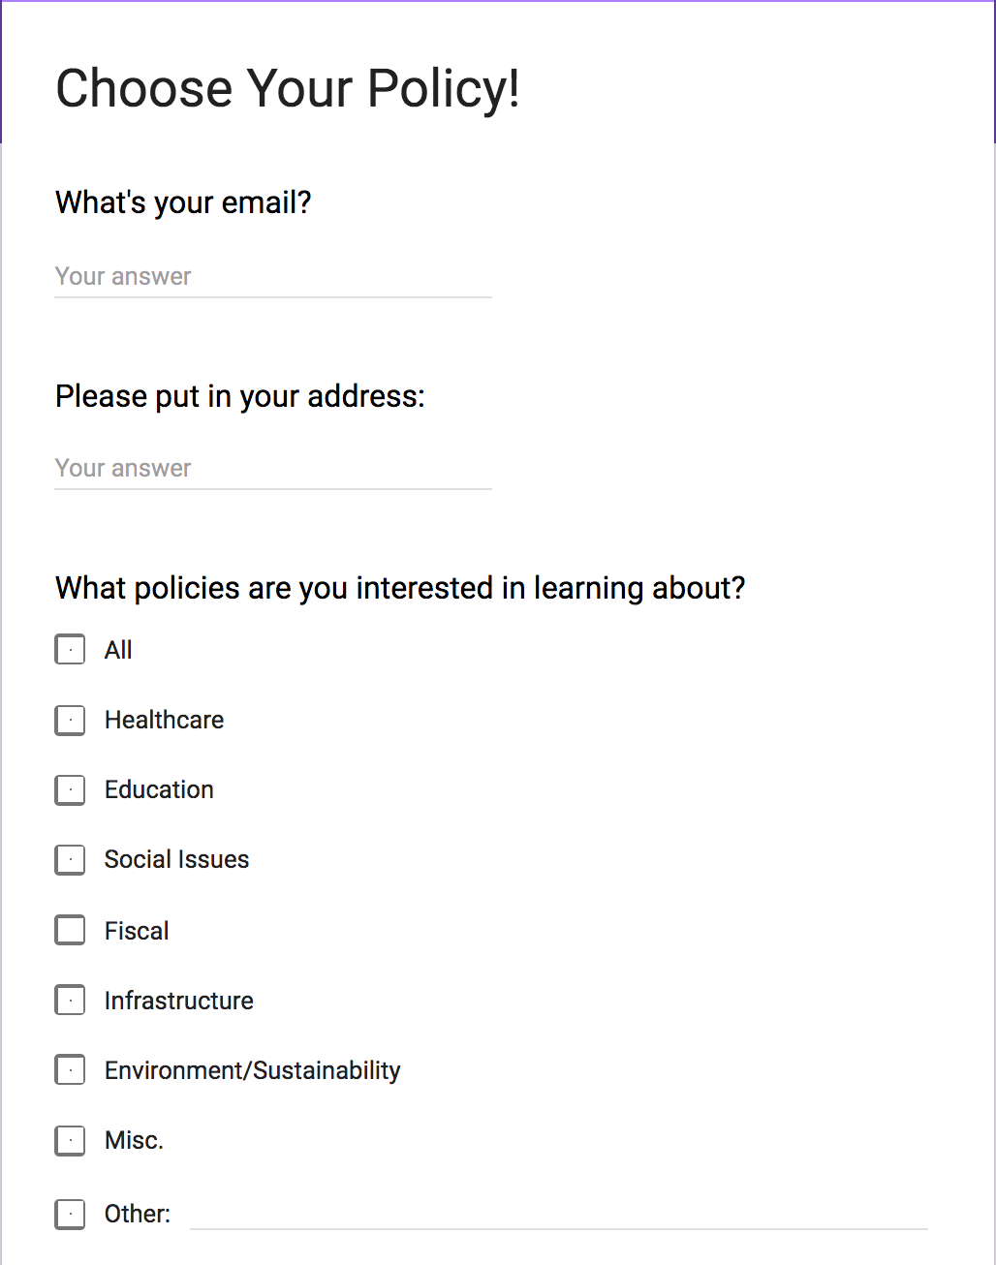
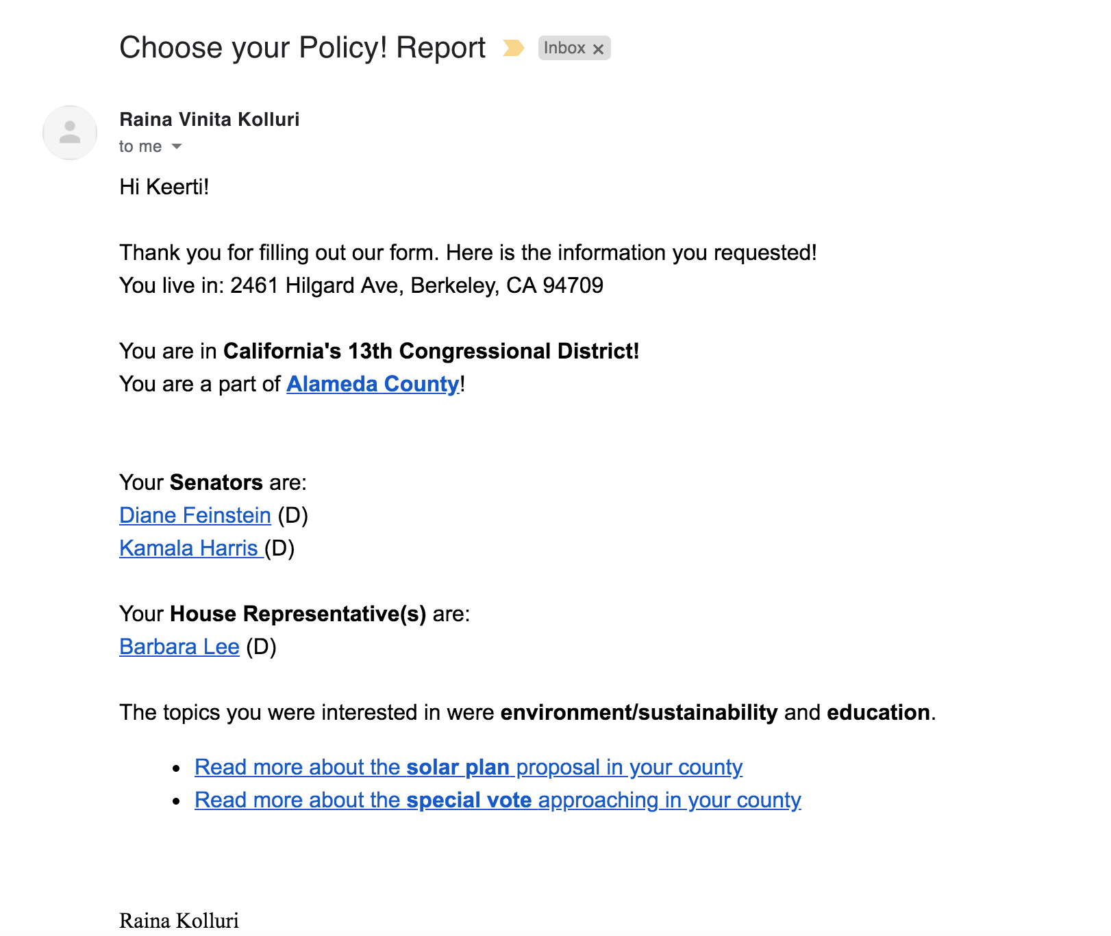
PROTOTYPE 2: Choose Your Policy!

Slide 17
Choose Your Policy
Assumption
Making politics personalized would make people more interested
Positives
Informative
Quick and faster than reading newspaper articles
Tailored information
Negatives
No motivation to complete
“Out of the way” of daily routine

Slide 18
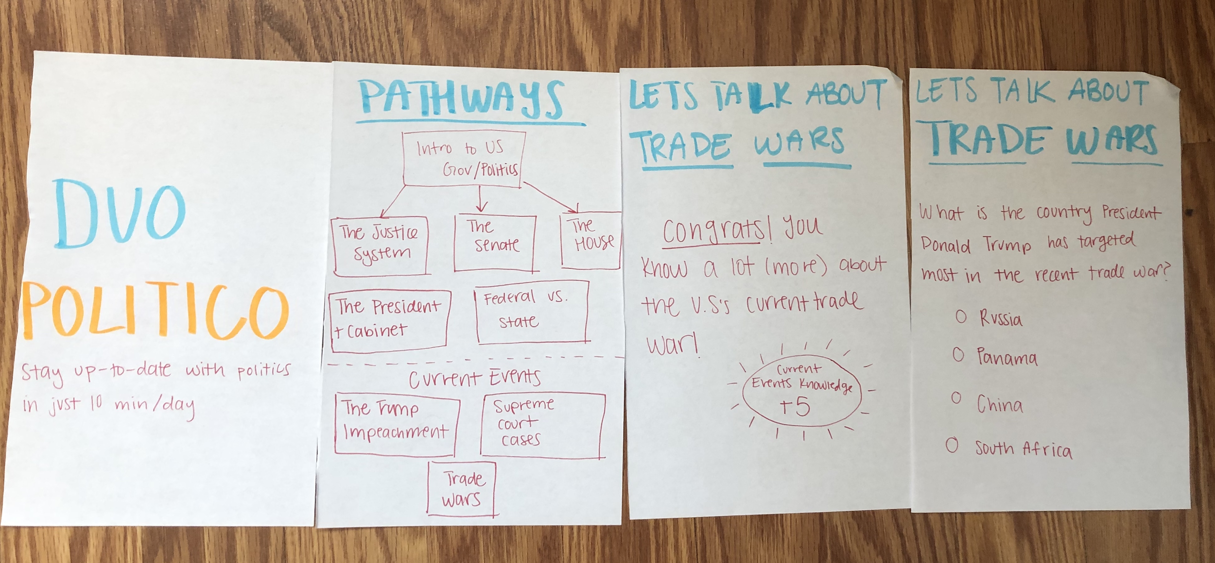
PROTOTYPE 3: DuoPolitico

Slide 19
DuoPolitico
Assumption
People will engage more if they can get educated quickly
Positives
Easy to use
Useful in deciding between candidates in the same party
Negatives
Too casual/not informative enough
Too much time
No continuous updating
Out of the way

Slide 20
How might we encourage continuous, fact-based, political engagement?
Key Takeaways
Notes:
This week was an extremely useful learning experience for our team. We were able to narrow down the scope of our project and started building genuine solutions to the problems we identified. Most importantly though, we learned more about the habits and needs of our users. First, we learned that people who are not significantly politically engaged are not willing to spend more than several minutes learning about politics each day. Second, we learned that people want a balance between entertainment and content. A platform that is purely educational was not appealing, but users also worried about the utility of a “gamified” political application. Finally, we learned that users enjoy when they are receiving political news relevant to their interests. This realization is more broad and will be useful in designing the “news choosing algorithm” aspect of our final project.
Out of all the prototypes we came up with, we achieved the best results with “Senate Meets House.” Many participants, with varying degrees of interest in politics, found the idea creative and delightful, but also informative. Relative to the other prototypes, “Senate Meets House” appealed the most to our target audience of young voters. However, we would like to refine it even further. We are excited to iterate and improve it over the next few weeks.

Slide 21
Thank you!

